Slide 1
That Good Good Bakery
Names

Slide 2
Description of Business
That Good Good Bakery is an Austin-based company focused on a bakery that produces innovative, traditional, and healthy bakery goods and products. The Company aims to achieve a preeminent position in the retail bakery industry channel based on the concept of cultivating loyal, brand specific consumer segments within the targeted market.

Slide 3
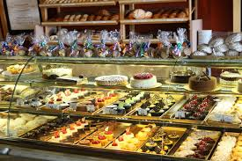
What we sell
Our bakery will include various types of cakes, cookies, muffins, fudge, brownies, pies and many more delicious treats. The staple product of our bakery will be delightful cookies baked by the one and only Emma Klepper.

Slide 4
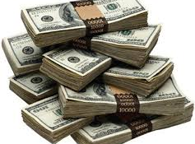
Our Goal
Our goal is to have a successful bakery that will deliver the best product to our customers. We also want to beat our competition, be the best bakery in our area, and make the most money.

Slide 5
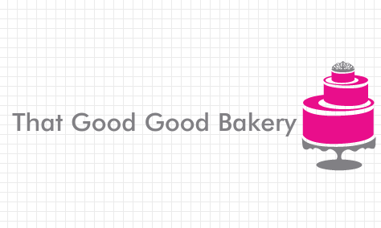
Why a bakery?
Inspiration to start a bakery came from our very own Emma Klepper. With her outstanding baking abilities we saw the perfect opportunity to create a business that highlights our talents.

Slide 6
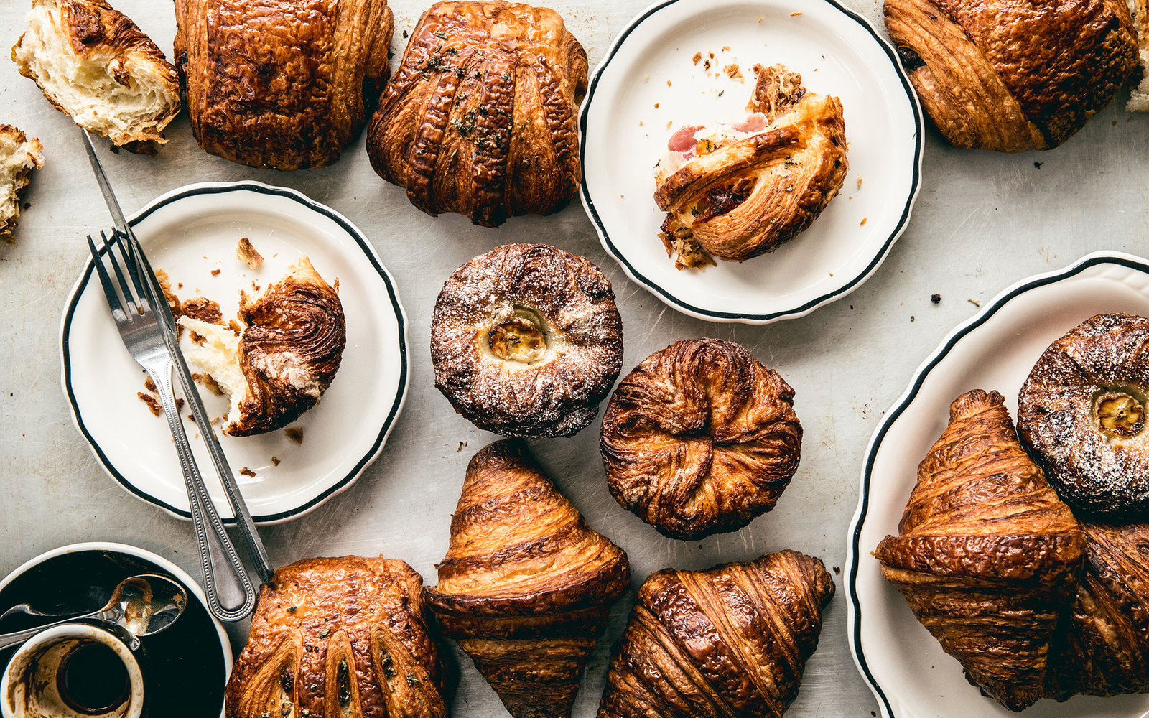
What we learned
Starting up your own small business is no easy task. It takes lots of consideration and planning to have a well run business. Everything from financial records to advertising requires a lot of consideration to make sure everything runs smoothly.

Slide 7
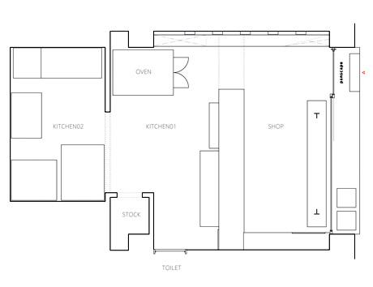
Floor Plan

Slide 8
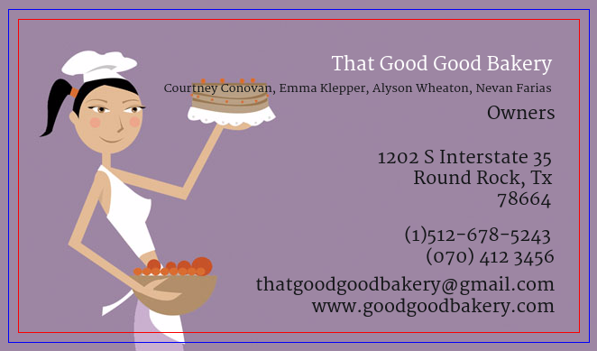
Logo and Business Card

Slide 9
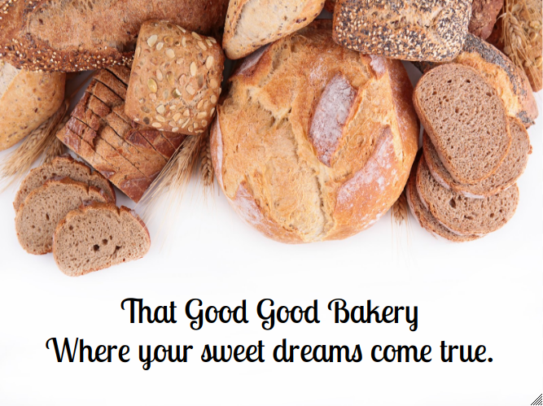
Billboard

