Slide 1
Introduction to Economics

Slide 2
Needs and Wants

Slide 3
Needs and Wants
Biological Needs

Slide 4
Needs and Wants
Biological Needs
Food
Water
Shelter

Slide 5
Needs and Wants
Societal Needs

Slide 6
Needs and Wants
Societal Needs
Comfort/Luxury
Security
Entertainment
Love/Acceptance

Slide 7
The Concern of Economics
What it’s about

Slide 8
The Concern of Economics
What it’s about
Our efforts to provide ourselves with our material needs and wants

Slide 9
Economic Resources (The Factors of Production)

Slide 10
Economic Resources (The Factors of Production)
Property Resources

Slide 11
Economic Resources (The Factors of Production)
Property Resources
Land
Capital

Slide 12
Economic Resources (The Factors of Production)
Human Resources

Slide 13
Economic Resources (The Factors of Production)
Human Resources
Labor
Entrepreneurs

Slide 14
The Three Basic Questions
What to Produce?
How to Produce?
For Whom to Produce?

Slide 15
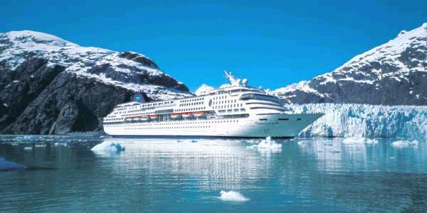
Economics Survivor
Last summer, you went on a fabulous Alaskan Cruise!

Slide 16
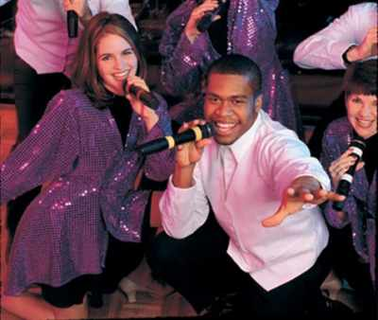
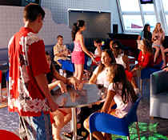
There was much fun to be had…

Slide 17
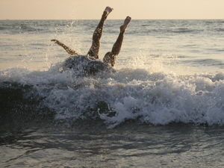
…but unfortunately, you and two of your friends fell overboard.

Slide 18
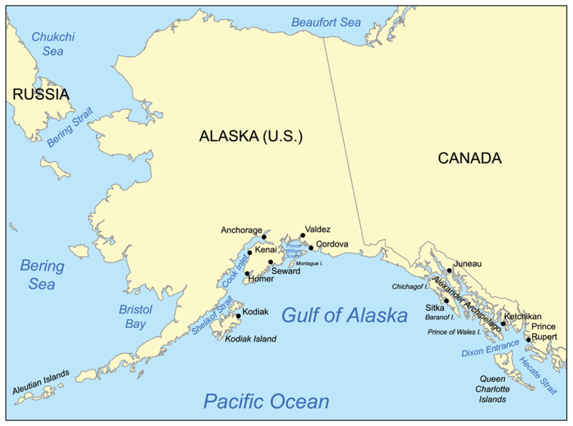
You are now stranded on a previously uncharted and unknown island to the south of Kodiak Island in the Gulf of Alaska.
You are here.

Slide 19
No one noticed you were missing.

Slide 20
You must now try to survive in the hopes that someday someone finds you. You cannot escape the island. Don’t even try.

Slide 21
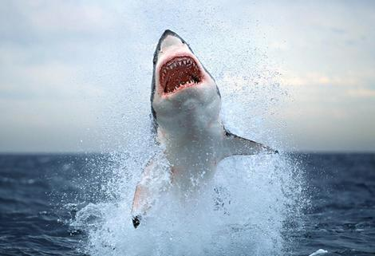
There are sharks out there.

Slide 22
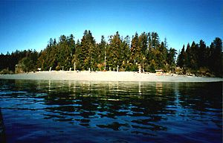
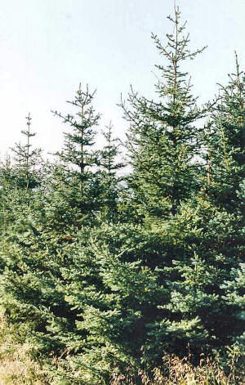
There is a sandy and rocky beach, and very rough cliffs. The interior of the island is mountainous, with thick forests of Douglas fir and Sitka spruce trees.

Slide 23
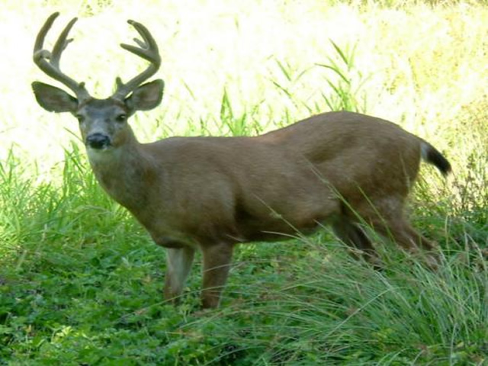
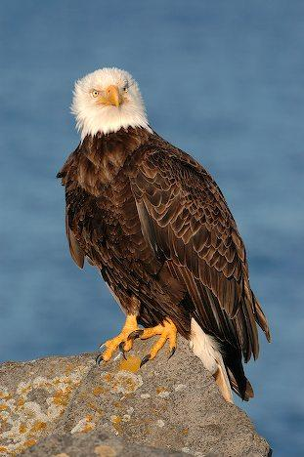
The wildlife consists of deer, rabbits, seagulls, eagles, fish and clams.
It has a mild, temperate climate (lucky for you it is summer), but the weather is very changeable.
There are frequent rain showers and fog can be heavy in the mornings and evenings..

Slide 24
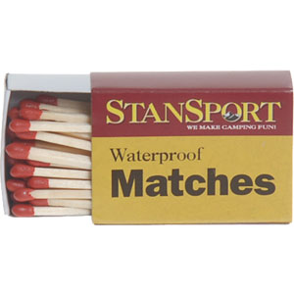
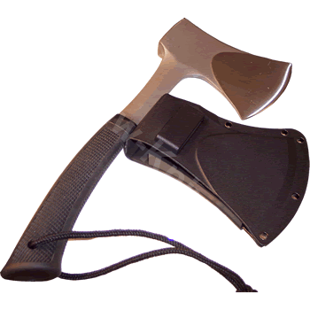
Your salvaged equipment:
You have
1 compass
2 rain ponchos
1 book of matches (dry)
2 knives
3 life preservers
2 paddles
1 small axe
And the wet clothes you are wearing.

Slide 25
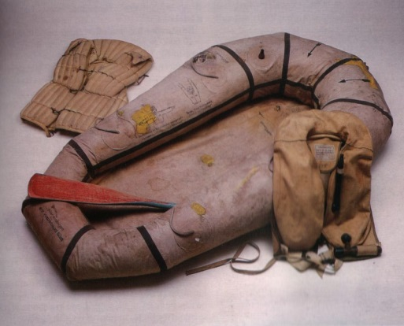
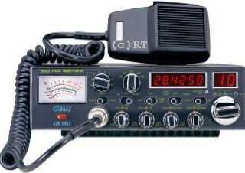
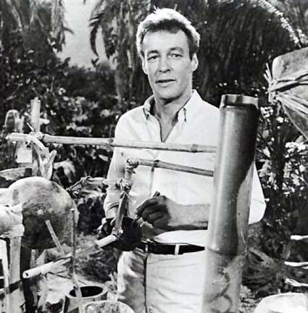
You do not have….
A lifeboat or raft (I have no idea why you have paddles!)
A radio
Any of the skills the Professor had on Gilligan’s Island. (Also, there are no coconuts.)

Slide 26
Your Task:
Write a survival plan and create a storyboard
(1 per group). It must include the following:
What are your resources? List all available land, capital, labor and entrepreneurial abilities.
How will you meet all of your biological and societal needs?
Minimum 8 panels
Please be detailed. Remember, escape is not an option. And, sadly, I must insist that neither murder and cannibalism nor suicide will be acceptable alternatives. Be creative!

Slide 27
Economics Survivor Rubric
You will need to demonstrate understanding of the following basic economic concepts through the pictures/words on your storyboard:
Three Basic Questions
_____ What to produce?
_____ How to produce?
_____ For Whom to produce?
Economic Resources
_____ Land
_____ Capital
_____ Labor
_____ Entrepreneurial Abilities
Biological/Societal Needs
_____ Food
_____ Water
_____ Shelter
_____ Comfort/Luxury
_____ Security
_____ Entertainment
Skills
_____ Creativity
_____ Participation
______ / 15 points Grade _________

Slide 28
The Fundamental Economic Problem

Slide 29
Scarcity
The wants and needs for material things among people in a society are unlimited
The economic resources to fulfill those wants and needs are limited
This limits our options and forces us to make choices

Slide 30
Opportunity Cost
The value of the next best alternative given up when a choice is made
TINSTAAFL – “There is no such thing as a free lunch”
Everything has a cost, but not necessarily a price

Slide 31
Trade-Offs
To get one thing, you must always give up something else
Every choice involves both costs and benefits that must be evaluated
Examples of Cost/Benefit Analysis

Slide 32
“The Invisible Hand”
Adam Smith, Wealth of Nations, 1776
Father of Economics
Consumers and producers, each acting in their own best interest, will ensure that the optimal output is produced.
Assumes rational behavior

Slide 33
Economics (further) Defined
“The science of economics is concerned with the efficient use of limited resources to achieve maximum satisfaction of human material wants.”
How to get the most stuff that people want at the least cost

Slide 34
Positive and Normative Economics
Positive Economics uses objective analysis to find out how the world works. The goal is to describe how things are. Ex: The unemployment rate is currently 7.6%
Normative Economics applies value judgments to data in order to recommend actions or policies. The goal is to describe how things should be.
Ex: 7.6% unemployment is too high and should be reduced using fiscal policy actions.

Slide 35
Economic Terminology
Goods
Services
Consumers
Value
(The Paradox of Value)
Utility
Wealth

