Slide 2
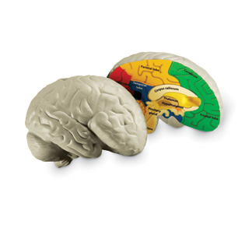
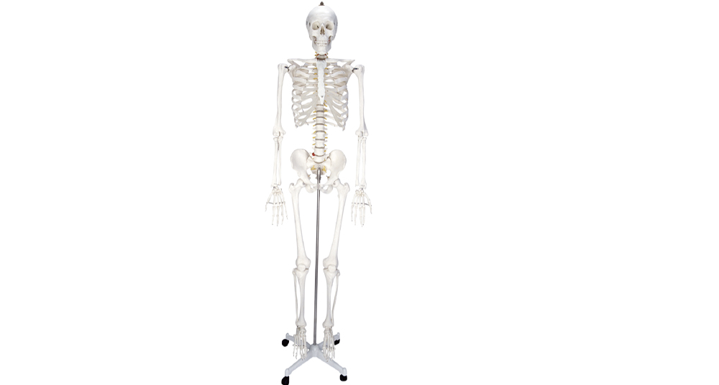
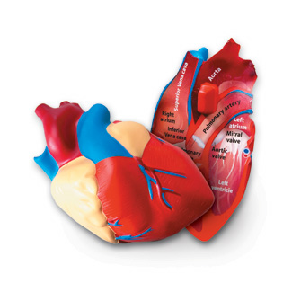

Slide 3
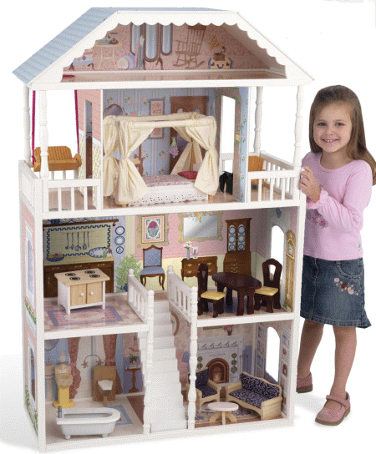
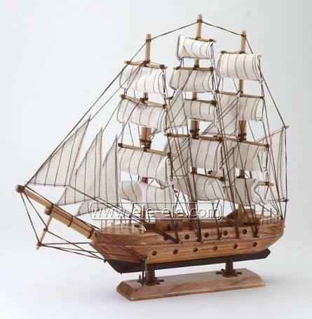

Slide 4
What is a model?
A miniature representation of a thing, with the several parts in due proportion; sometimes, a facsimile of the same size.
Something intended to serve, or that may serve, as a pattern of something to be made; a material representation or embodiment of an ideal; sometimes, a drawing; a plan; as, the clay model of a sculpture; the inventor's model of a machine.
Anything which serves, or may serve, as an example for imitation; as, a government formed on the model of the American constitution; a model of eloquence, virtue, or behavior.
That by which a thing is to be measured; standard.
Any copy, or resemblance, more or less exact.

Slide 5
Production Possibilities Frontiers

Slide 6
Production Possibilities Frontier
(PPF/PPC)
Consumer Goods (Pizza)
Capital Goods (Robots)

Slide 7
Scarcity – unlimited wants, limited resources
Consumer Goods (Pizza)
Production Possibilities Frontier
(PPF/PPC)
100
Capital Goods (Robots)
50

Slide 8
Scarcity – unlimited wants, limited resources
Consumer Goods (Pizza)
Production Possibilities Frontier
(PPF/PPC)
100
Capital Goods (Robots)
50

Slide 9
Scarcity – unlimited wants, limited resources
Opportunity costs and trade-offs
Consumer Goods (Pizza)
Production Possibilities Frontier
(PPF/PPC)
100
a
b
.
Capital Goods (Robots)
50

Slide 10
Scarcity – unlimited wants, limited resources
Opportunity costs and trade-offs
Consumer Goods (Pizza)
Production Possibilities Frontier
(PPF/PPC)
100
a
90
b
.
50
Capital Goods (Robots)
25
45
50

Slide 11
Scarcity – unlimited wants, limited resources
Opportunity costs and trade-offs
Consumer Goods (Pizza)
Production Possibilities Frontier
(PPF/PPC)
100
a
90
Cost = 40 pizzas
b
.
50
Benefit = 20 robots
Capital Goods (Robots)
25
45
50

Slide 12
Scarcity – unlimited wants, limited resources
Opportunity costs and trade-offs
Efficiency – two kinds
Productive: producing at the least cost (any pt. on the PPF)
Allocative: producing the goods and services most wanted by society (a particular pt. on the PPF)
Consumer Goods (Pizza)
Production Possibilities Frontier
(PPF/PPC)
100
a
90
Cost = 40 pizzas
b
.
50
Benefit = 20 robots
Capital Goods (Robots)
25
45
50

Slide 13
Scarcity – unlimited wants, limited resources
Opportunity costs and trade-offs
Efficiency – two kinds
Productive: producing at the least cost (any pt. on the PPF)
Allocative: producing the goods and services most wanted by society (a particular pt. on the PPF)
Consumer Goods (Pizza)
Production Possibilities Frontier
(PPF/PPC)
100
a
90
Cost = 40 pizzas
c
b
.
50
Inefficient – unemployed resources
Benefit = 20 robots
Capital Goods (Robots)
25
45
50

Slide 14
Scarcity – unlimited wants, limited resources
Opportunity costs and trade-offs
Efficiency – two kinds
Productive: producing at the least cost (any pt. on the PPF)
Allocative: producing the goods and services most wanted by society (a particular pt. on the PPF)
Consumer Goods (Pizza)
Production Possibilities Frontier
(PPF/PPC)
100
a
90
Cost = 40 pizzas
policy
c
b
.
50
Inefficient – unemployed resources
Benefit = 20 robots
Capital Goods (Robots)
25
45
50

Slide 15
Scarcity – unlimited wants, limited resources
Opportunity costs and trade-offs
Efficiency – two kinds
Productive: producing at the least cost (any pt. on the PPF)
Allocative: producing the goods and services most wanted by society (a particular pt. on the PPF)
Consumer Goods (Pizza)
Production Possibilities Frontier
(PPF/PPC)
100
a
d
90
Cost = 40 pizzas
policy
c
b
.
50
Inefficient – unemployed resources
Benefit = 20 robots
Capital Goods (Robots)
25
45
50

Slide 16
Scarcity – unlimited wants, limited resources
Opportunity costs and trade-offs
Efficiency – two kinds
Productive: producing at the least cost (any pt. on the PPF)
Allocative: producing the goods and services most wanted by society (a particular pt. on the PPF)
Consumer Goods (Pizza)
Production Possibilities Frontier
(PPF/PPC)
100
a
d
Unattainable with current resources and technology
90
Cost = 40 pizzas
policy
c
b
.
50
Inefficient – unemployed resources
Benefit = 20 robots
Capital Goods (Robots)
25
45
50

Slide 17
Scarcity – unlimited wants, limited resources
Opportunity costs and trade-offs
Efficiency – two kinds
Productive: producing at the least cost (any pt. on the PPF)
Allocative: producing the goods and services most wanted by society (a particular pt. on the PPF)
Consumer Goods (Pizza)
Production Possibilities Frontier
(PPF/PPC)
100
a
d
Unattainable with current resources and technology
90
Cost = 40 pizzas
policy
c
b
.
50
Inefficient – unemployed resources
Benefit = 20 robots
Capital Goods (Robots)
25
45
50

Slide 18
Scarcity – unlimited wants, limited resources
Opportunity costs and trade-offs
Efficiency – two kinds
Productive: producing at the least cost (any pt. on the PPF)
Allocative: producing the goods and services most wanted by society (a particular pt. on the PPF)
Consumer Goods (Pizza)
Production Possibilities Frontier
(PPF/PPC)
100
a
d
Unattainable with current resources and technology
90
Cost = 40 pizzas
policy
c
b
.
50
Inefficient – unemployed resources
Economic Growth
Benefit = 20 robots
Capital Goods (Robots)
Economic Growth = SOL
Increased quality of human resources (EDUCATION) or technology (INVESTMENT)
25
45
50

Slide 19
Scarcity – unlimited wants, limited resources
Opportunity costs and trade-offs
Efficiency – two kinds
Productive: producing at the least cost (any pt. on the PPF)
Allocative: producing the goods and services most wanted by society (a particular pt. on the PPF)
Consumer Goods (Pizza)
Production Possibilities Frontier
(PPF/PPC)
100
Developing nation
a
d
Unattainable with current resources and technology
90
Cost = 40 pizzas
policy
c
b
U.S.
50
Inefficient – unemployed resources
Economic Growth
Benefit = 20 robots
Capital Goods (Robots)
Economic Growth = SOL
Increased quality of human resources (EDUCATION) or technology (INVESTMENT)
25
45
50

Slide 20
Scarcity – unlimited wants, limited resources
Opportunity costs and trade-offs
Efficiency – two kinds
Productive: producing at the least cost (any pt. on the PPF)
Allocative: producing the goods and services most wanted by society (a particular pt. on the PPF)
Consumer Goods (Pizza)
Production Possibilities Frontier
(PPF/PPC)
NOW
100
Developing nation
a
d
Unattainable with current resources and technology
90
Cost = 40 pizzas
policy
c
b
U.S.
50
Inefficient – unemployed resources
Economic Growth
Benefit = 20 robots
Capital Goods (Robots)
Economic Growth = SOL
Increased quality of human resources (EDUCATION) or technology (INVESTMENT)
25
45
50
FUTURE

Slide 21
Scarcity – unlimited wants, limited resources
Opportunity costs and trade-offs
Efficiency – two kinds
Productive: producing at the least cost (any pt. on the PPF)
Allocative: producing the goods and services most wanted by society (a particular pt. on the PPF)
Consumer Goods (Pizza)
Production Possibilities Frontier
(PPF/PPC)
NOW
Economic Interdependence
100
Developing nation
a
d
Unattainable with current resources and technology
90
Cost = 40 pizzas
policy
c
b
U.S.
50
Inefficient – unemployed resources
Economic Growth
Benefit = 20 robots
Capital Goods (Robots)
Economic Growth = SOL
Increased quality of human resources (EDUCATION) or technology (INVESTMENT)
25
45
50
FUTURE

Slide 22
Scarcity – unlimited wants, limited resources
Opportunity costs and trade-offs
Efficiency – two kinds
Productive: producing at the least cost (any pt. on the PPF)
Allocative: producing the goods and services most wanted by society (a particular pt. on the PPF)
Consumer Goods (Pizza)
Production Possibilities Frontier
(PPF/PPC)
NOW
Economic Interdependence
100
Developing nation
a
d
Unattainable with current resources and technology
90
Cost = 40 pizzas
policy
c
b
U.S.
50
Inefficient – unemployed resources
Economic Growth
Benefit = 20 robots
Capital Goods (Robots)
Economic Growth = SOL
Increased quality of human resources (EDUCATION) or technology (INVESTMENT)
25
45
50
Investment = purchase of capital goods
FUTURE

Slide 23
Circular Flow Diagram

Slide 24
Consumers
(Households)
Producers
(Businesses)

Slide 25
Consumers
(Households)
A market is
anything that
brings together
buyers and sellers
Producers
(Businesses)

Slide 26
Consumers
(Households)
Product Market
(goods/services)
Producers
(Businesses)

Slide 27
Consumers
(Households)
Resource Market
(land, labor, capital, entrepreneurs)
Product Market
(goods/services)
Producers
(Businesses)

Slide 28
Consumers
(Households)
Get a job!
Resource Market
(land, labor, capital, entrepreneurs)
Product Market
(goods/services)
Producers
(Businesses)

Slide 29
Consumers
(Households)
Get a job!
Resource Market
(land, labor, capital, entrepreneurs)
Product Market
(goods/services)
Producers
(Businesses)
Hire you!

Slide 30
Consumers
(Households)
Get a job!
Resource Market
(land, labor, capital, entrepreneurs)
Product Market
(goods/services)
Producers
(Businesses)
Hire you!
Make stuff!

Slide 31
Buy stuff!
Consumers
(Households)
Get a job!
Resource Market
(land, labor, capital, entrepreneurs)
Product Market
(goods/services)
Producers
(Businesses)
Hire you!
Make stuff!

Slide 32
Buy stuff!
Consumers
(Households)
Get a job!
Spend $!
Resource Market
(land, labor, capital, entrepreneurs)
Product Market
(goods/services)
Producers
(Businesses)
Hire you!
Make stuff!

Slide 33
Buy stuff!
Consumers
(Households)
Get a job!
Spend $!
Resource Market
(land, labor, capital, entrepreneurs)
Product Market
(goods/services)
Revenue$
Producers
(Businesses)
Hire you!
Make stuff!

Slide 34
Buy stuff!
Consumers
(Households)
Get a job!
Spend $!
Resource Market
(land, labor, capital, entrepreneurs)
Product Market
(goods/services)
Pay You! $
Revenue$
Producers
(Businesses)
Hire you!
Make stuff!

Slide 35
Buy stuff!
Consumers
(Households)
Get a job!
Get Paid! $
Spend $!
Resource Market
(land, labor, capital, entrepreneurs)
Product Market
(goods/services)
Pay You! $
Revenue$
Producers
(Businesses)
Hire you!
Make stuff!

Slide 36
Buy stuff!
Consumers
(Households)
Get a job!
Get Paid! $
Spend $!
All parts of the circular flow diagram are dependent on all other parts!
Resource Market
(land, labor, capital, entrepreneurs)
Product Market
(goods/services)
Pay You! $
Revenue$
Producers
(Businesses)
Hire you!
Make stuff!

Slide 37
The End

